Slide 1
CS 4350: Fundamentals of Software Engineering Lesson 7.1 Introduction to Testing and TDD
Adeel Bhutta, Frank Tip, Jan Vitek, Mitch Wand
Khoury College of Computer Sciences
© 2021 Released under the CC BY-SA license

Slide 2
Learning Objectives for this Lesson
By the end of this lesson, you should be able to:
Describe the elements of a test and how they are used;
State Dijkstra’s law and its relevance;
Classify tests by purpose, scope and size;
Explain why test automation is important.
Define “Test-Driven Development”;
Contrast two different phases for programming in TDD;
Outline the strengths and weaknesses of TDD.

Slide 3
Working Definition
Software Testing is the process of checking if software meets certain concrete requirements
“certain” – a finite set
“concrete” – particular, not symbolic
Testing is carried out by execution of the software.
Next: definitions “SUT” and “Test”

Slide 4
SUT = System Under Test
The “System Under Test” consists of its
Inputs
State
Outputs
State Change
(Other) Behavior
System
State
State Change
Inputs
Outputs
Behavior

Slide 5
Running a Test
Construct the situation:
Set up SUT to get the state ready
[Optional: Prepare collaborators]
Apply the operation inputs.
Check the outputs, verify the state change, handle the behavior
Handle exceptions,
Time-Out to handle nontermination,
Post-check with collaborators.

Slide 6

Dijkstra’s Law
“Program testing can be used to show the presence of bugs, but never to show their absence!” – Edsger Dijkstra
The state space of a SUT is (usually) infinite, but testing can only execute a finite number of tests.
Even if the state space is finite, it may still be too large to make exhaustive testing feasible.
And this ignores the fallibility of tests. What if the tests are in error?

Slide 7
Classifying Tests
We can classify tests according to several cross-cutting dimensions:
Scope: What sort of thing is the SUT?
Purpose: Why are we testing?
Size: What resources does testing need?
How: How is testing performed?

Slide 8
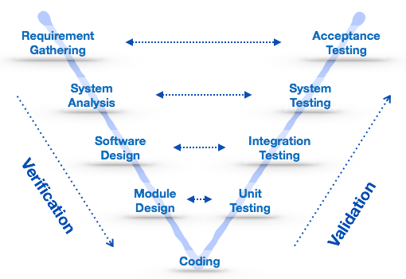
Test Scope
Unit tests: SUT = a single method/class/object
Integration tests: SUT = combinations of units, a subsystem
System tests: SUT = whole system being developed
Verification: "Are we building the product right?"
Validation: "Are we building the right product?"

Slide 9
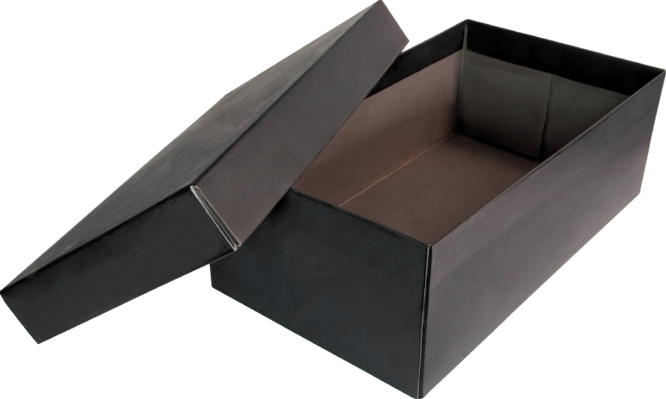

Test Purpose
Acceptance Test
Customer-level requirement testing
Validation: Are we building the right system ?
Functional Test
“Black-Box” testing
Specification Testing
Structural Test
“White-Box” testing
Exercising the code
Regression Test
Prevent bugs from (re-)entering during maintenance.
Functional “black box”
Structural “white box”

Slide 10
Test Size
We begin by ‘testing-in-the-small’ and move toward ‘testing-in-the-large’
Small: run on a single process, no blocking I/O
Fast to run; can be run automatically and frequently
Medium: run on a single machine, no network I/O (only localhost); “hermetic”
May be slower; delayed to overnight runs
Large/Enormous tests: run on a network.
May have serious $$$ cost in network services or personnel.
See SoftEng @ Google Chapter 11
https://learning.oreilly.com/library/view/software-engineering-at/9781492082781/ch11.html#testing_overview

Slide 11
Manner of Testing
Automated tests can be run without supervision
Suitable for frequent automated runs
Manual tests require a human to run and evaluate
A human may be needed to check UI elements
Tests may be ill-defined and nondeterministic
e.g., trying to “break” software
Customer-facing tests require an intermediary to evaluate as well as the customer to use the software.

Slide 12
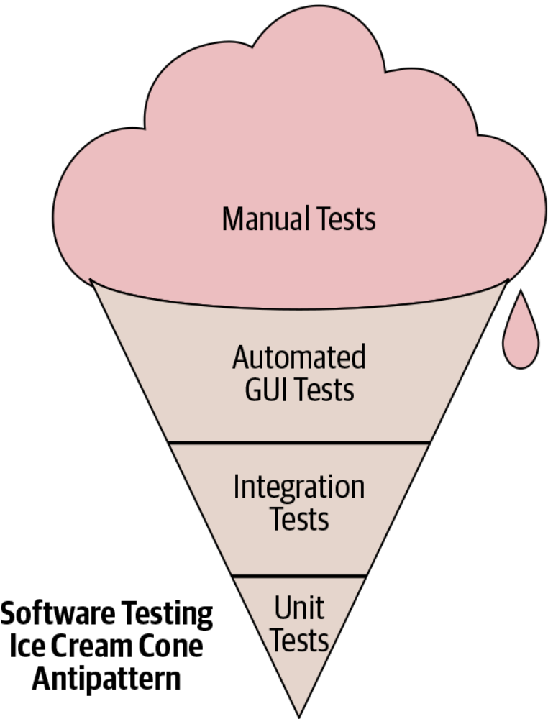
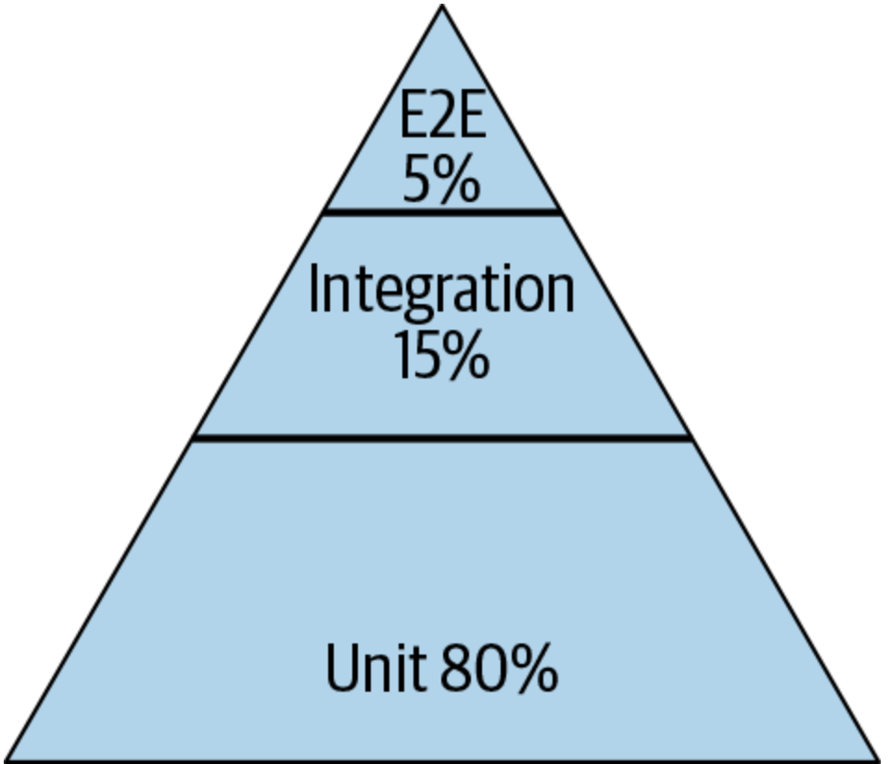
Test Distribution (Size/Scope/Manner)
Pyramid
Test Pattern
From SoftEng @ Google Chapter 11
https://learning.oreilly.com/library/view/software-engineering-at/9781492082781/ch11.html#testing_overview

Slide 13
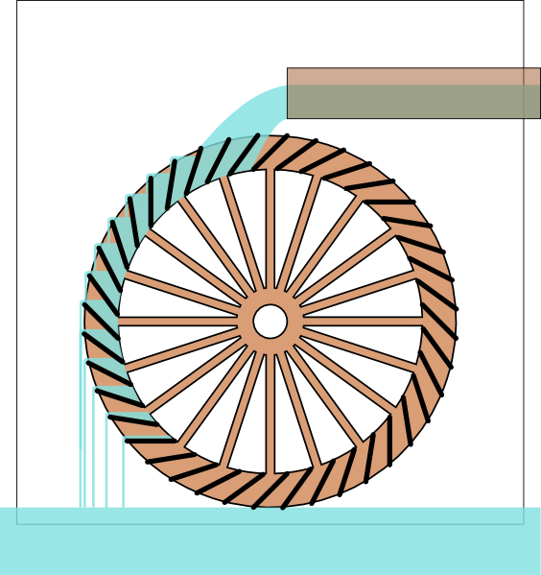
Test-Driven Development (1)
From outside, the development is driven by “issues”:
New feature requests;
Enhancement requests;
Bug reports;
Internal feature requests.
Issues are the “water” in our “TDD = water wheel” metaphor.
Issues

Slide 14
Test-Driven Development (2)
The first task is to write a test.
The test should fail.
A bug report is not actionable until we have replicated it.
A feature request is not actionable until we know what how it should work.
Tests are the “buckets” in our metaphor.
Issues
Write test

Slide 15
Test-Driven Development (3)
Then we fix the code:
Change code until test passes;
All previous tests must pass too (no regression!);
No redesigns; goal is to fix as quickly as possible.
Coding turns the wheel until the “water” is gone (issue is fixed).
Issues
Write test
Fix code

Slide 16
Test-Driven Development (4)
Clean up code:
At leisure, “refactor” code;
Not driven by issues;
No (visible) behavior changes;
All tests must still pass;
Improve maintainability.
Refactoring borrows momentum to turn the wheel without the action of “water.”
Issues
Write test
Refactor
code
Refactoring
Fix code

Slide 17
Caveats & Qualifications
Typically, a new feature will require multiple tests
The “fix” should not just be the minimum to pass the test(s)
The programmer should keep in mind the spec/requirements.
But the fix should be the simplest possible that addresses the issue.
Tests are run frequently and thus must be fast and deterministic.
Occasionally, the tests may need to be fixed as well.

Slide 18
Strengths
Goals are concrete and actionable.
We revisit requirements frequently:
We make sure we are building the right product;
Mistakes are fixed earlier.
Separate refactoring stage means code hygiene is not forgotten.
Test portfolio gives confidence in maintenance.

Slide 19
Weaknesses
Often the same person writes the test and implements the code being tested
Blind spots: programmer may overlook something;
Gentleness: programmer may avoid “hard” tests.
Tests can add to maintenance problems
Slow, flaky or brittle tests can slow down ”wheel” (both fixing code and refactoring)
As defined, TDD is perhaps overly strict. (Discuss!)

Slide 20
Variants
Acceptance Test Driven Development (ATDD)
Write “system” tests to express user requirements.
These tests may be “large” and/or “slow”.
Some may not be automatable.
Behavior Test Driven Development (BTDD)
Uses structured natural language to describe user stories with desired behavior.
Also “system” tests.

Slide 21
Review
Now that you've studied this lesson, you should be able to:
Describe the elements of a test and how they are used;
State Dijkstra’s law and its relevance;
Classify tests by purpose, scope and size;
Explain why test automation is important.
Define “Test-Driven Development”;
Contrast two different phases for programming in TDD;
Outline the strengths and weaknesses of TDD.

